Slide 1
Containers & Orchestration

Slide 2
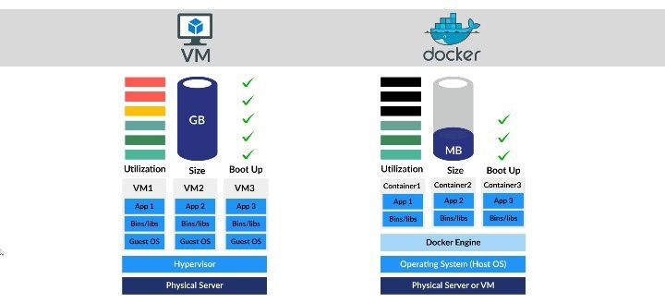
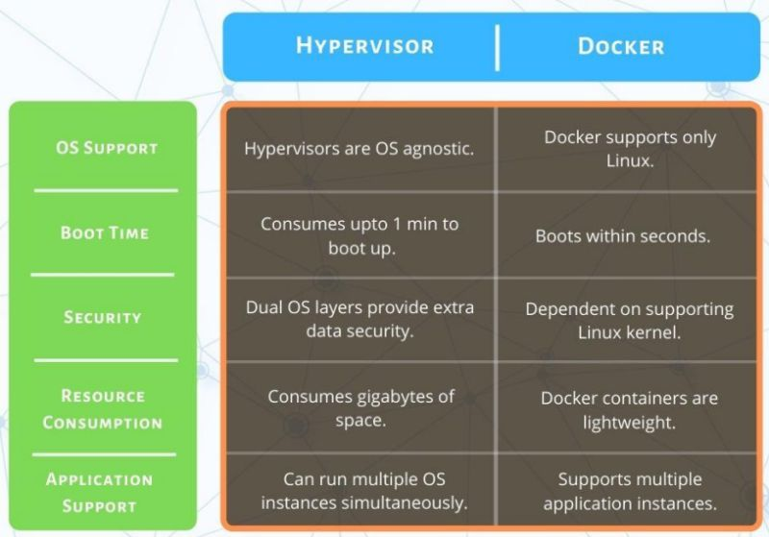
VM vs Container

Slide 3
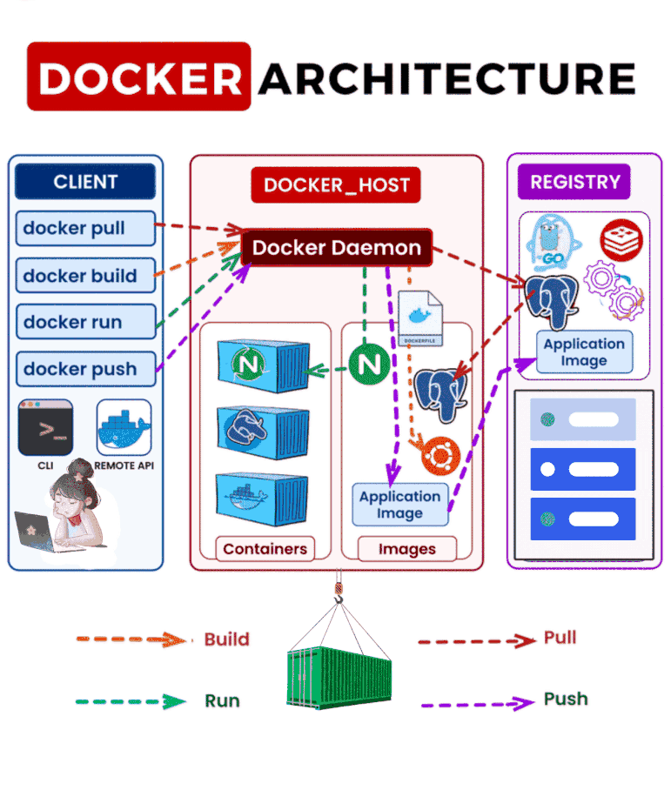
1. **𝑫𝒐𝒄𝒌𝒆𝒓 𝑪𝒍𝒊𝒆𝒏𝒕**🔧 🖥️: The command-line interface (CLI) where we interact with Docker by running commands like `docker build`, `docker run`, and more. It communicates with the Docker Daemon. 2. **𝑫𝒐𝒄𝒌𝒆𝒓 𝑫𝒂𝒆𝒎𝒐𝒏** ⚙️: This is the engine running behind the scenes 🏭. The Daemon listens to Docker Client commands and manages images, containers, networks, and volumes. 3. **𝑫𝒐𝒄𝒌𝒆𝒓 𝑰𝒎𝒂𝒈𝒆𝒔** 📦: Immutable blueprints used to create containers. Each image is built step by step using layers, making them lightweight and easily shareable. 4. **𝑫𝒐𝒄𝒌𝒆𝒓 𝑪𝒐𝒏𝒕𝒂𝒊𝒏𝒆𝒓𝒔** 🛳️: The real magic happens here! Containers are isolated environments where applications run. They’re portable and efficient, ensuring your app runs the same way on any system. 5. **𝑫𝒐𝒄𝒌𝒆𝒓 𝑹𝒆𝒈𝒊𝒔𝒕𝒓𝒚** 🗂️: A centralized storage for Docker images. Public registries like Docker Hub host millions of images, and you can also set up private registries for your organization.

Slide 4
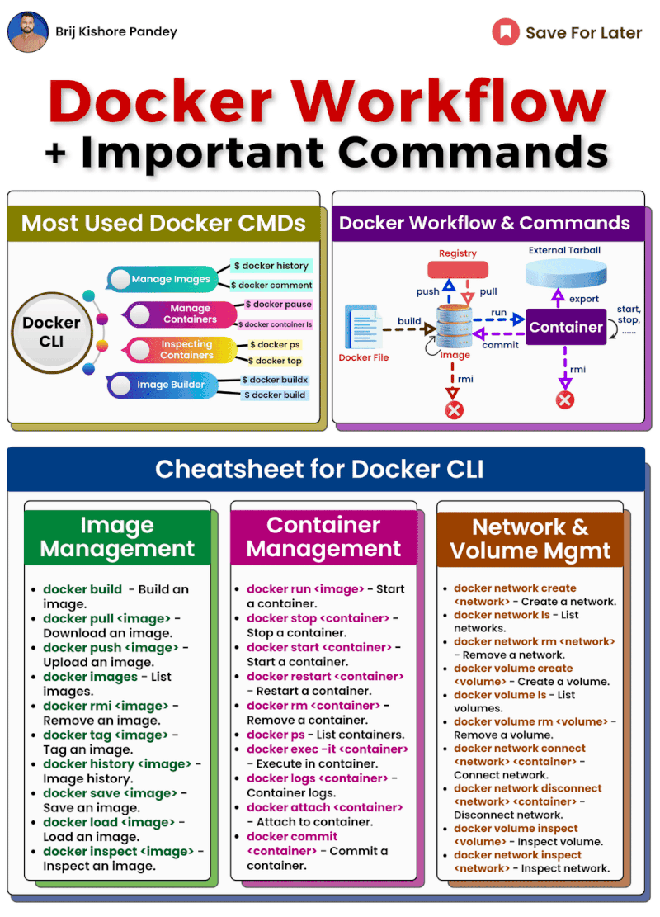
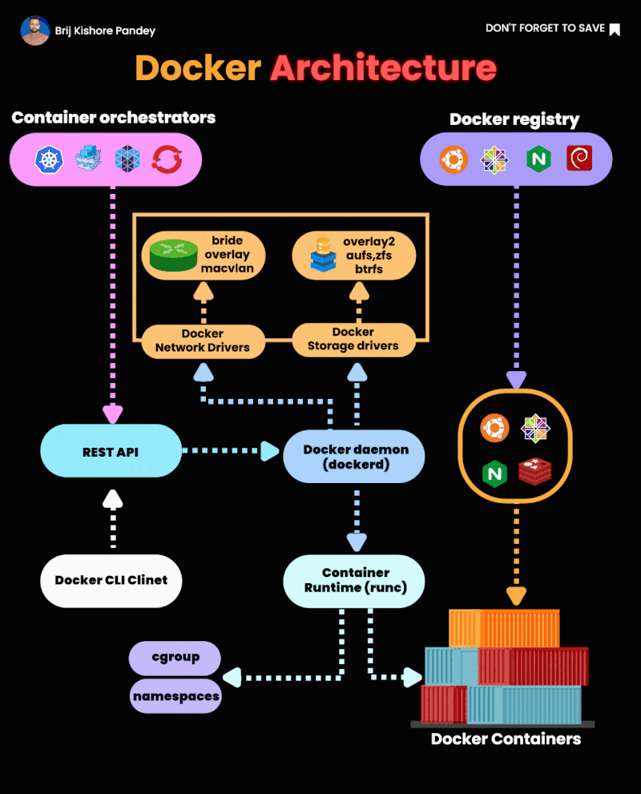

Slide 5
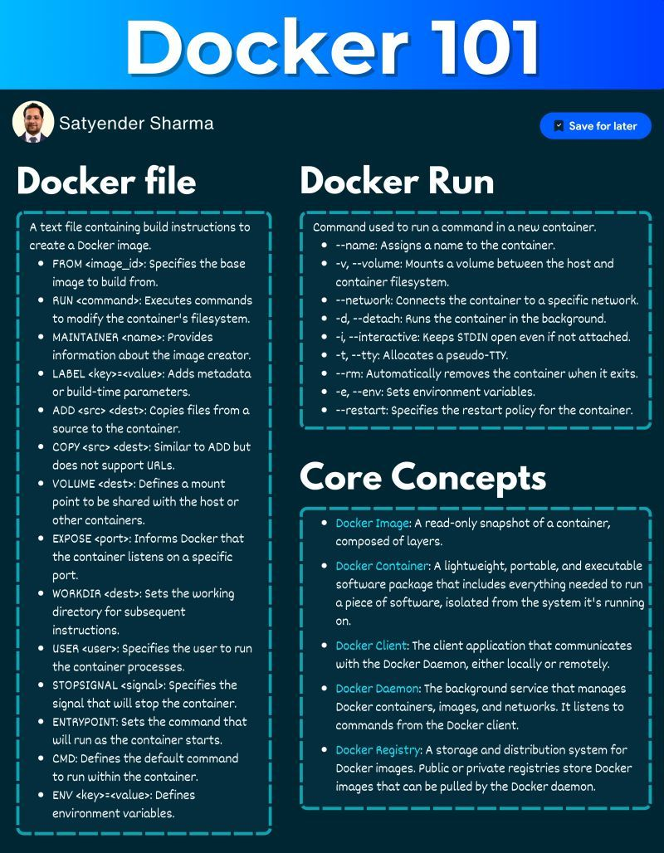
𝐃𝐨𝐜𝐤𝐞𝐫𝐟𝐢𝐥𝐞 𝐈𝐧𝐬𝐭𝐫𝐮𝐜𝐭𝐢𝐨𝐧𝐬: - FROM: Sets the base image. - RUN: Executes commands in the container. - MAINTAINER: Identifies the image creator. - LABEL: Adds metadata. - ADD: Copies files (supports URLs). - COPY: Copies files (no URLs). - VOLUME: Creates a shared mount point. - EXPOSE: Specifies listening port. - WORKDIR: Sets the working directory. - USER: Defines the user for processes. - STOPSIGNAL: Specifies stop signal. - ENTRYPOINT: Sets the start command. - CMD: Sets the default command. - ENV: Sets environment variables.
𝐂𝐨𝐫𝐞 𝐃𝐨𝐜𝐤𝐞𝐫 𝐂𝐨𝐧𝐜𝐞𝐩𝐭𝐬: - Docker Image: Read-only snapshot of a container. - Docker Container: Executable package with software and dependencies. - Docker Client: Tool to interact with Docker. - Docker Daemon: Service managing Docker objects. - Docker Registry: Storage for Docker images.

Slide 6
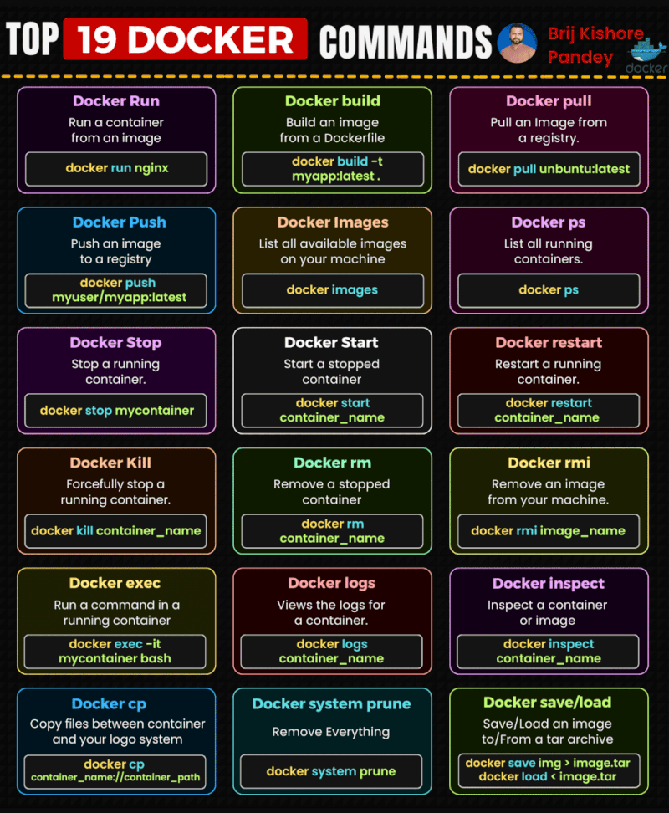
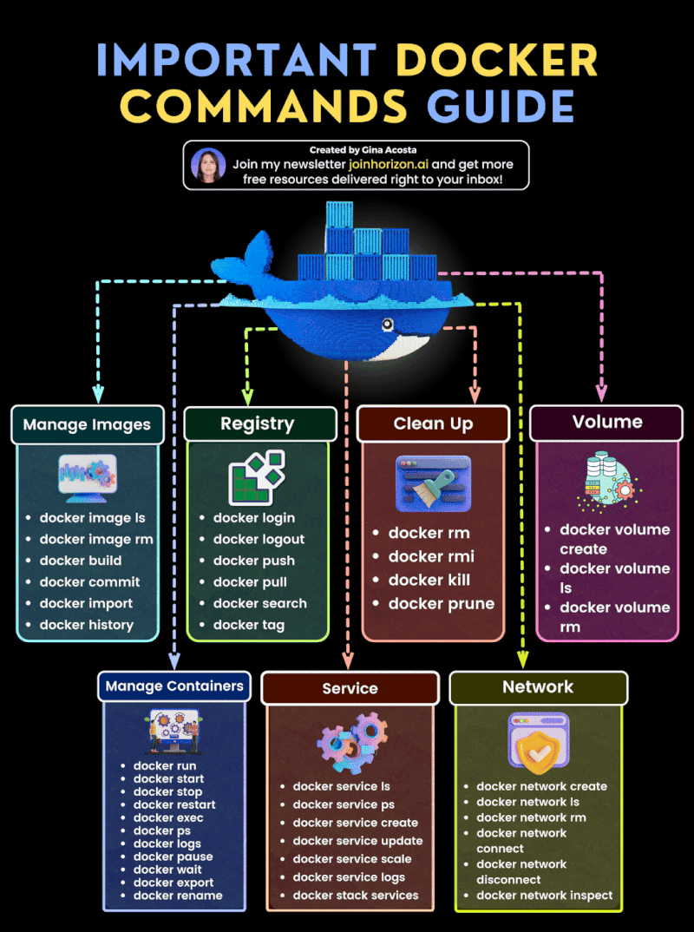

Slide 7
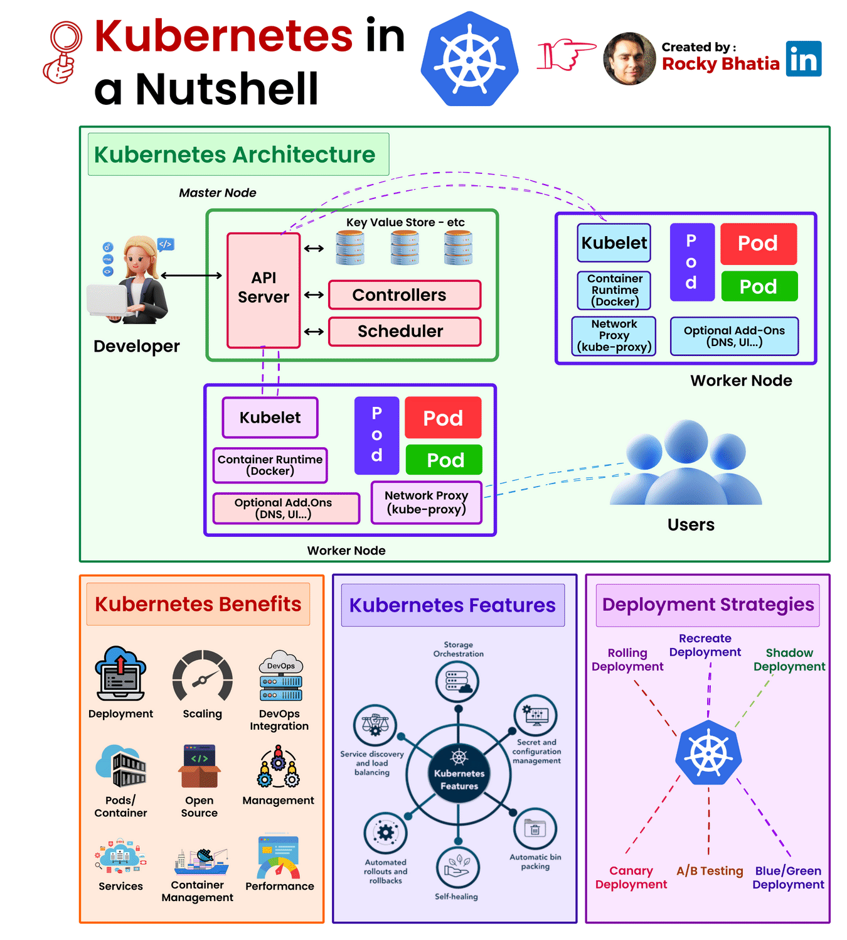
https://www.devopsschool.com/blog/kubernetes-in-a-nutshell/

Slide 8
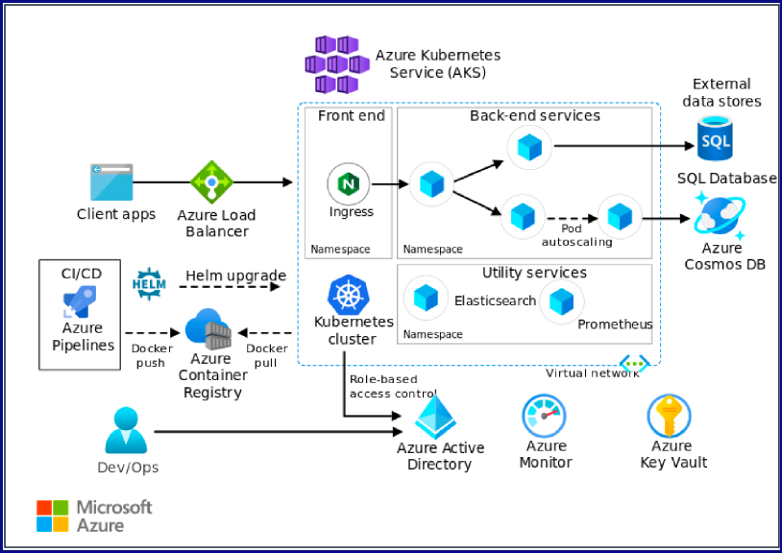

Slide 9
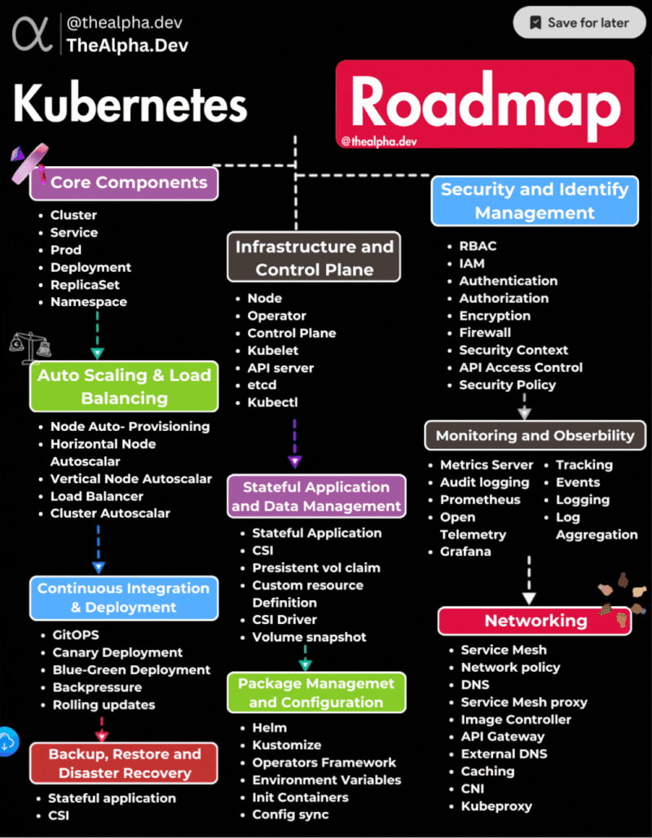
Notes:
𝐊𝐮𝐛𝐞𝐫𝐧𝐞𝐭𝐞𝐬 𝐑𝐨𝐚𝐝𝐦𝐚𝐩 𝑱𝒐𝒊𝒏 𝑶𝒖𝒓 𝑻𝒆𝒄𝒉 𝑪𝒐𝒎𝒎𝒖𝒏𝒊𝒕𝒚 -> 𝑮𝒖𝒊𝒅𝒆 𝑶𝒕𝒉𝒆𝒓’𝒔 -> 𝑾𝒊𝒏 𝑬𝒙𝒄𝒊𝒕𝒊𝒏𝒈 𝑹𝒆𝒘𝒂𝒓𝒅𝒔 ->https://app.thealpha.dev/ 🔒 𝐒𝐞𝐜𝐮𝐫𝐢𝐭𝐲 𝐚𝐧𝐝 𝐈𝐝𝐞𝐧𝐭𝐢𝐭𝐲 𝐌𝐚𝐧𝐚𝐠𝐞𝐦𝐞𝐧𝐭 - RBAC - IAM - Authentication - Authorization - Encryption - Firewall - Security Context - API Access Control - Security Policy ⚙️𝐈𝐧𝐟𝐫𝐚𝐬𝐭𝐫𝐮𝐜𝐭𝐮𝐫𝐞 𝐚𝐧𝐝 𝐂𝐨𝐧𝐭𝐫𝐨𝐥 𝐏𝐥𝐚𝐧𝐞 - Node Operator - Control Plane - Kubelet - API server - etcd - Kubectl ⚖️ 𝐀𝐮𝐭𝐨 𝐒𝐜𝐚𝐥𝐢𝐧𝐠 & 𝐋𝐨𝐚𝐝 𝐁𝐚𝐥𝐚𝐧𝐜𝐢𝐧𝐠 - Node Auto-Provisioning - Horizontal Node Autoscalar - Vertical Node Autoscalar - Load Balancer - Cluster Autoscalar 🚢 𝐂𝐨𝐧𝐭𝐢𝐧𝐮𝐨𝐮𝐬 𝐈𝐧𝐭𝐞𝐠𝐫𝐚𝐭𝐢𝐨𝐧 & 𝐃𝐞𝐩𝐥𝐨𝐲𝐦𝐞𝐧𝐭 - GitOPS - Canary Deployment - Blue-Green Deployment - Backpressure - Rolling updates - Backup, Restore, and Disaster Recovery 📦 𝐏𝐚𝐜𝐤𝐚𝐠𝐞 𝐌𝐚𝐧𝐚𝐠𝐞𝐦𝐞𝐧𝐭 𝐚𝐧𝐝 𝐂𝐨𝐧𝐟𝐢𝐠𝐮𝐫𝐚𝐭𝐢𝐨𝐧 - Helm - Kustomize - Operators Framework - Environment Variables - Init Containers - Config sync 🔍 𝐌𝐨𝐧𝐢𝐭𝐨𝐫𝐢𝐧𝐠 𝐚𝐧𝐝 𝐎𝐛𝐬𝐞𝐫𝐯𝐚𝐛𝐢𝐥𝐢𝐭𝐲 - Metrics Server - Audit logging - Prometheus - Open Telemetry - Grafana - Tracking - Events - Logging - Log Aggregation 🌐 𝐍𝐞𝐭𝐰𝐨𝐫𝐤𝐢𝐧𝐠 - Service Mesh - Network policy - DNS - Service Mesh proxy - Image Controller - API Gateway - External DNS - Caching - CNI - Kubeproxy 🔄 𝐒𝐭𝐚𝐭𝐞𝐟𝐮𝐥 𝐀𝐩𝐩𝐥𝐢𝐜𝐚𝐭𝐢𝐨𝐧 𝐚𝐧𝐝 𝐃𝐚𝐭𝐚 𝐌𝐚𝐧𝐚𝐠𝐞𝐦𝐞𝐧𝐭 - CSI - Stateful Application CSI - Persistent vol claim - Custom Resource Definition - CSI Driver - Volume snapshot Ready to elevate your Kubernetes journey? Explore these topics to master container orchestration and build scalable, resilient applications! 🚀💡 𝑱𝒐𝒊𝒏 𝑶𝒖𝒓 𝑻𝒆𝒄𝒉 𝑪𝒐𝒎𝒎𝒖𝒏𝒊𝒕𝒚 -> 𝑮𝒖𝒊𝒅𝒆 𝑶𝒕𝒉𝒆𝒓’𝒔 -> 𝑾𝒊𝒏 𝑬𝒙𝒄𝒊𝒕𝒊𝒏𝒈 𝑹𝒆𝒘𝒂𝒓𝒅𝒔 ->https://app.thealpha.dev/

Slide 10
https://github.com/mspnp/aks-baseline
https://github.com/Azure/aks-baseline-automation
https://github.com/Azure/AKS-Construction
https://github.com/sathishphcl/container-apps-store-api-microservice
https://github.com/Gordonby/aksc-petclinic
https://github.com/Azure/sg-aks-workshop
https://github.com/Gordonby/AKS-K8S-Lab-L200

